Slide 1
Problem representation and estimating energy usage costs
With Josh Dean

Slide 2

Kampala, Uganda

Slide 3

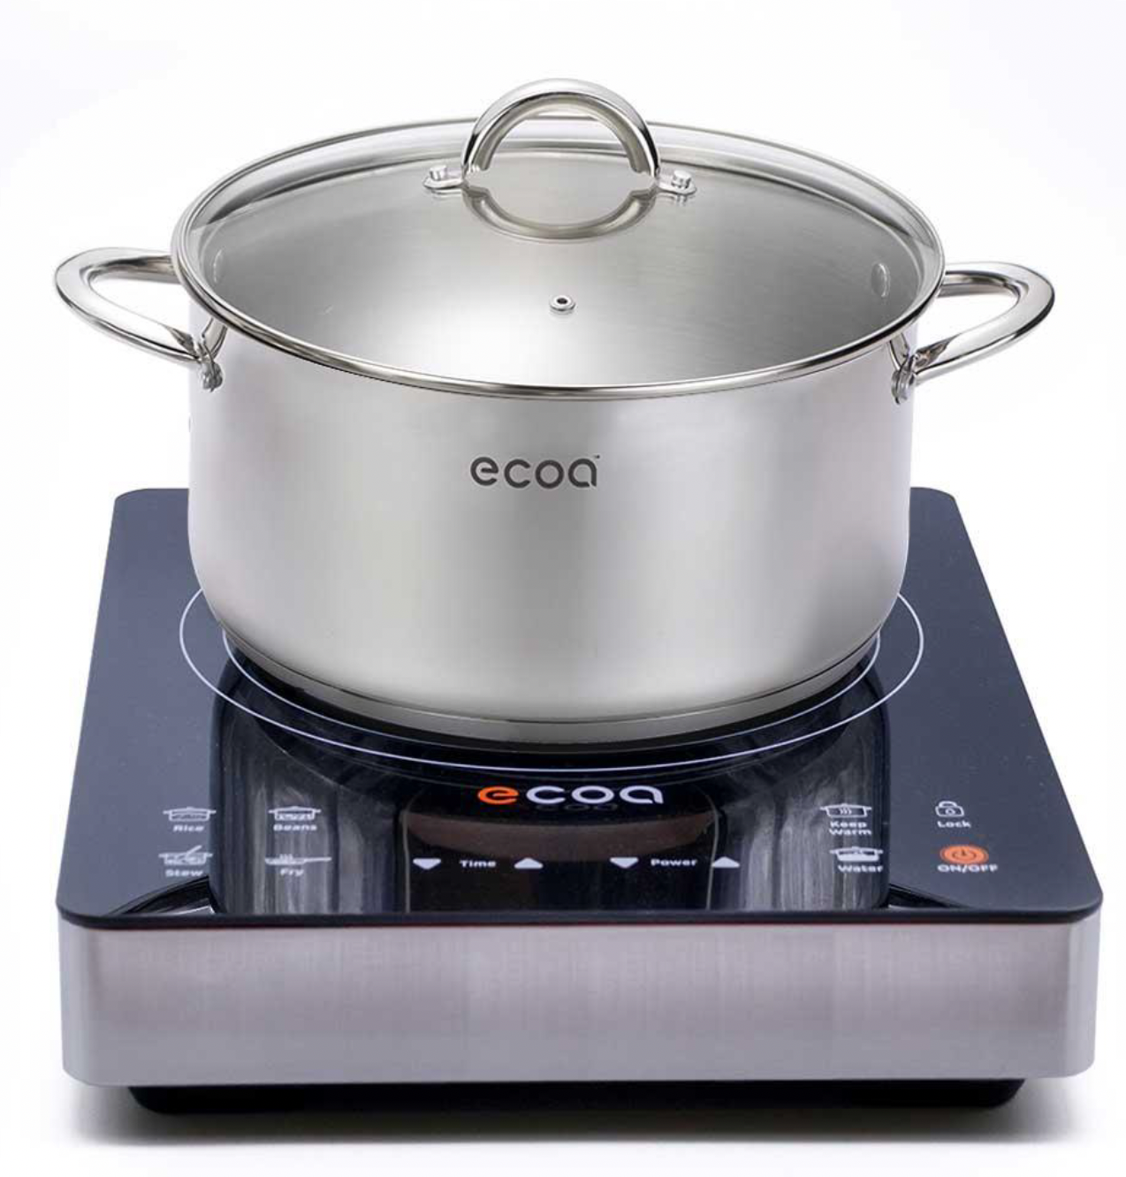
Which will cost more money to use?

Slide 4
Some important context

Slide 5
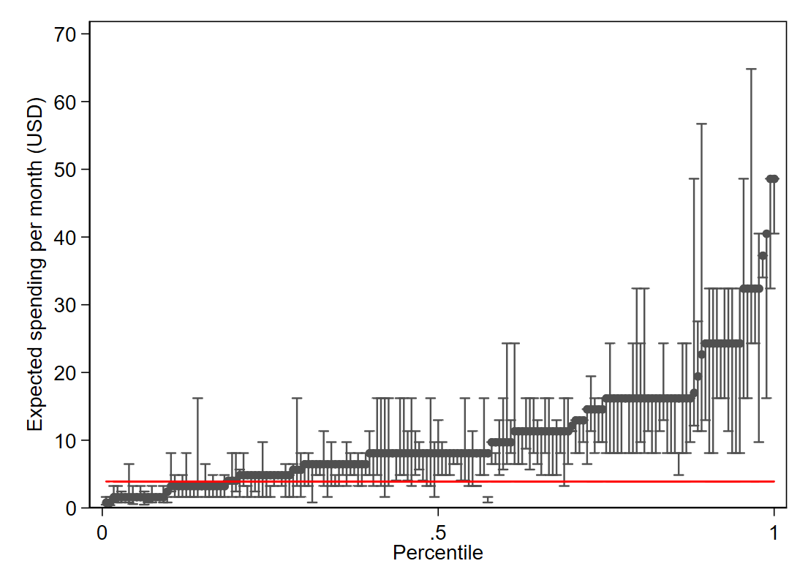
Beliefs are all over the place
“Suppose you buy the ECOA electric stove and cook with it for 1 hour every day on a medium setting.
This will use electricity and cause your electricity payment to increase by some amount.
What is your best guess of what that increase might be per week?
What do you think is the smallest that increase might be per week?
What do you think is the largest that increase might be per week?”

Slide 6

More information doesn’t seem to help

Slide 7
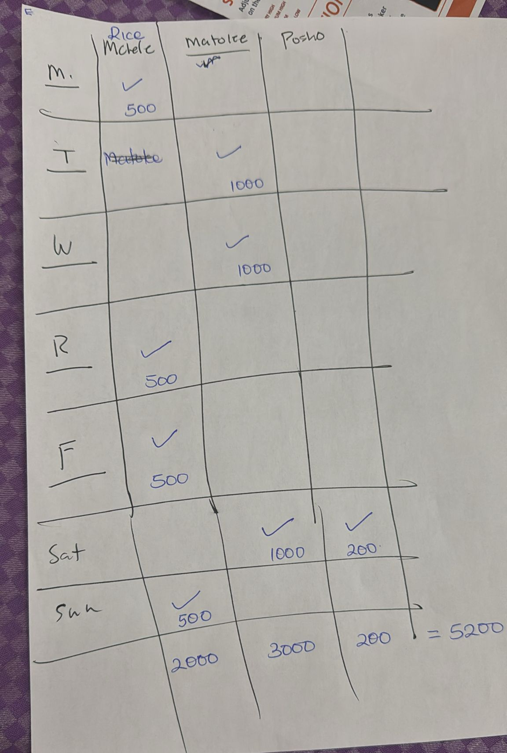
But setting up the problem seems to

Slide 8
Basic design of the experiment
Randomize guides to setting up the problem
Elicit electricity cost beliefs + vary accuracy incentives
Elicit willingness to pay
Randomize ownership and observe outcomes
Randomize electricity subsidies

Slide 9
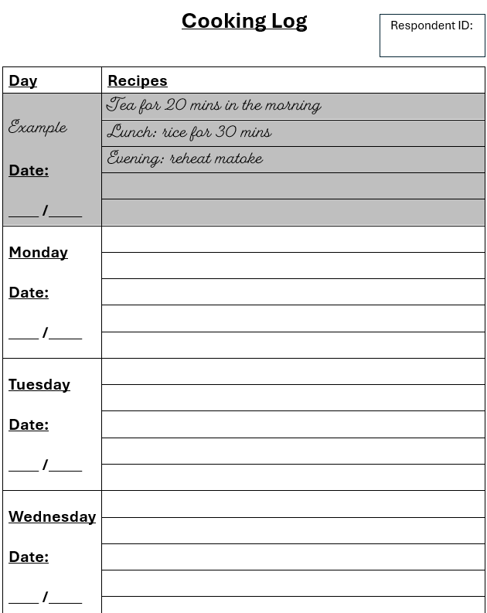
Baseline survey
Record a cooking diary for 1 week

Slide 10
Random treatments
Full sample
(2,000)
No information
(400)
Information
(400)
Information + Representation
(400)
Information + Practice problem
(800)
Is providing information about the marginal cost sufficient?
Do individuals need a way to represent the problem to be able to process the information?
Do individuals simply need to have experience setting up similar problems?

Slide 11
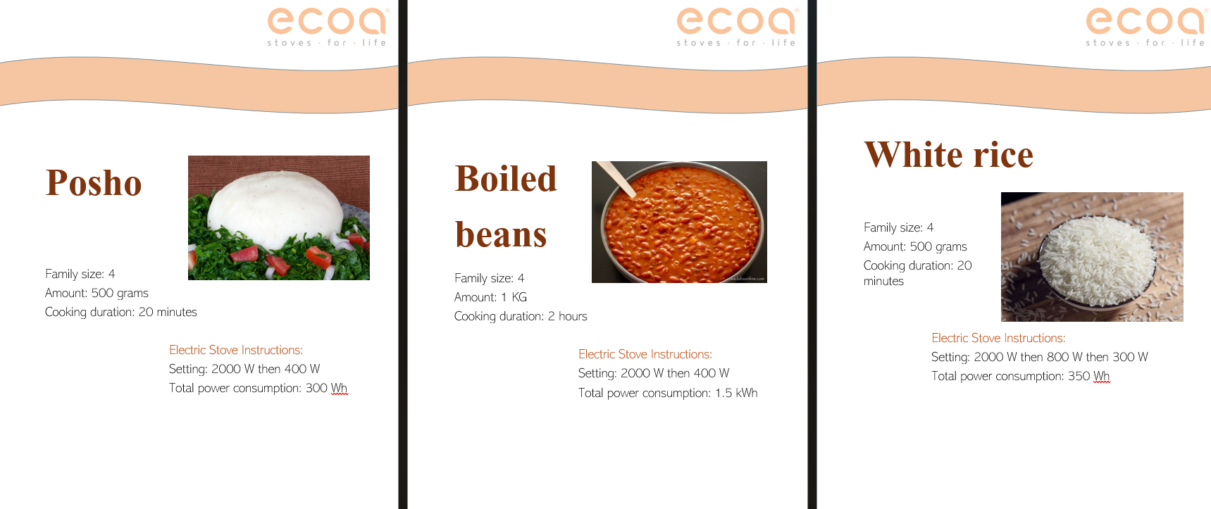
No information
Recipe book without costs listed

Slide 12
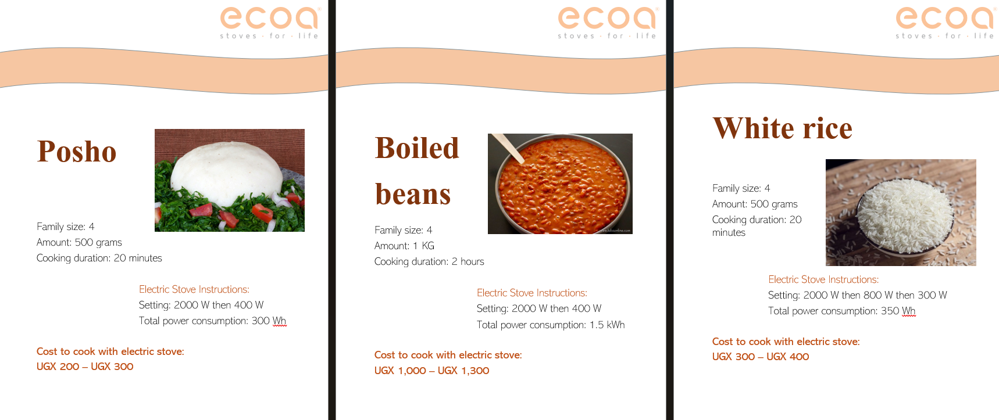
Information (“energy labeling”)
Recipe book with costs listed
Individualized recipe books will incorporate a randomized electricity subsidy

Slide 13
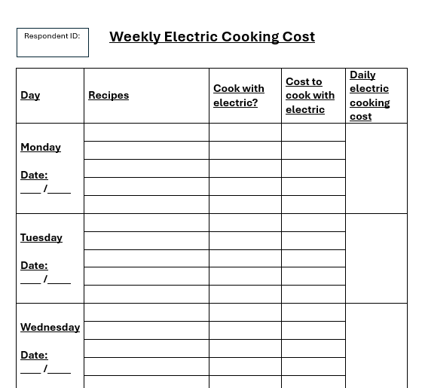
Representation
Structuring the problem

Slide 14
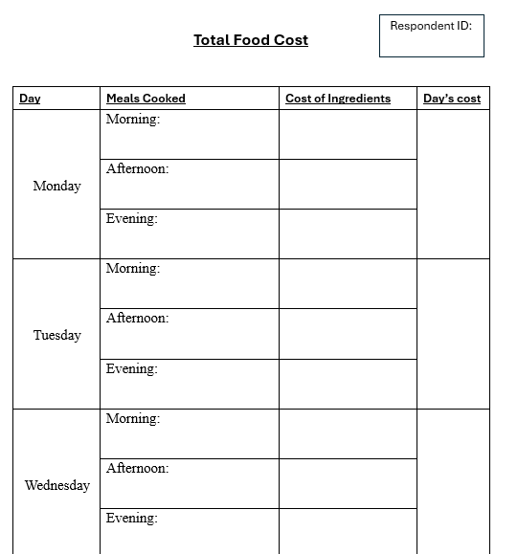
Helpful practice problem
Weekly grocery costs: Total

Slide 15
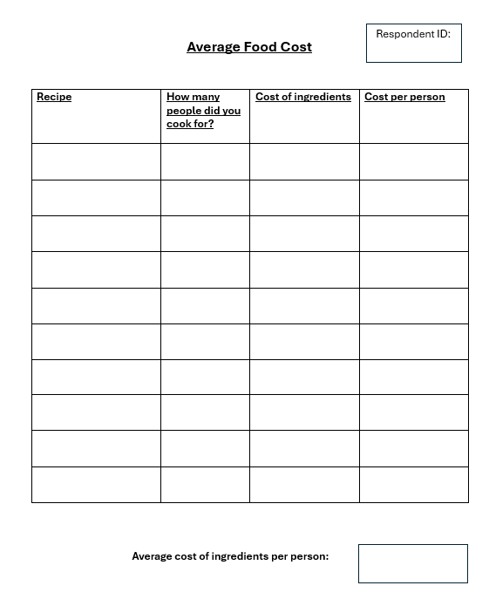
Harmful practice problem
Weekly grocery costs: Average

Slide 16
Full sample
(2,000)
No information
(400)
Information
(400)
Harmful practice problem
(400)
No prompt
(200)
Prompt
(200)
Information + Representation
(400)
Helpful practice problem
(400)
No prompt
(200)
Prompt
(200)
Information + Practice problem
(800)

Slide 17
Outcome variables:
“Think of others in this neighborhood who are like you in terms of what they cook and how often they cook. How much more money would they spend on electricity for this stove each week? You will get $X if you guess correctly.”
Incentive randomization: $X = [0, 2, 10, 50]
Elicit WTP using BDM
Type I error: Usage and loan repayment rates
Impact of electricity subsidies on WTP and usage

Slide 18
Visit 2
- Stove price subsidies
- Representation treatment
- BDM elicitation
- Stove transaction
Visit 1
- Enrollment
Visit Year 1
- Long-term
Endline survey
Visit 3
- Endline survey
t = - 30
t = 0
t = 30
t = 60
t = 365
Self-reports
Cooking diary
Charcoal usage SMS survey
Measurement
High-frequency charcoal stove temperature measurement
High-frequency induction stove usage measurement
Treatment
Stove usage electricity subsidies (0%, 25%, 75%)

Slide 19
Demand wedges and the efficiency of fixed and marginal subsidies: Evidence from induction stoves
With Josh Dean

Slide 20
Should policy makers subsidize fixed or marginal costs?
Many technologies require adoption + usage
Electric vehicles
Induction stoves
Planner can subsidize fixed costs or marginal costs
Electric vehicle subsidies
Electricity tariffs

Slide 21
Should policy makers subsidize fixed or marginal costs?
First-best: marginal transfer = externality, fixed transfer = 0
Adopters face frictions that dampen WTP: information neglect*
These demand wedges lower the efficacy of marginal cost subsidies
These demand wedges increase the efficacy of fixed cost subsidies

Slide 22
Treatments
0%, 25%, or 75% marginal cost subsidy (informed prior to BDM)
Impact will be both selection and TE
25% or 75% fixed cost subsidy
(Approximately the same $ cost per week as the electricity subsidies)
Reducing information neglect*

Slide 23
Testable hypotheses
In the presence of a demand wedge, fixed cost subsidies are more effective ($ per tCO₂ abated) than marginal cost subsidies
Aggregate emissions: factors in usage elasticity, etc.
Removing the demand wedge causes:
Fixed cost subsidies to be less effective
Marginal cost subsidies to be more effective
Marginal cost subsidies to have a larger impact on WTP
The marginal adopter under a fixed cost subsidy to have on average lower usage
The marginal adopter under a marginal cost subsidy to have on average higher usage
Marginal cost subsidies to better induce selection towards high-usage agents (less Type I error)

Slide 24
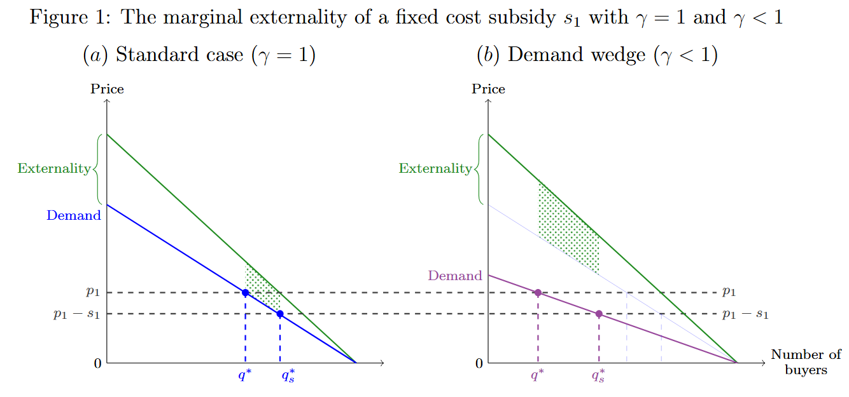
Theory: Marginal adopter has a higher externality

Slide 25
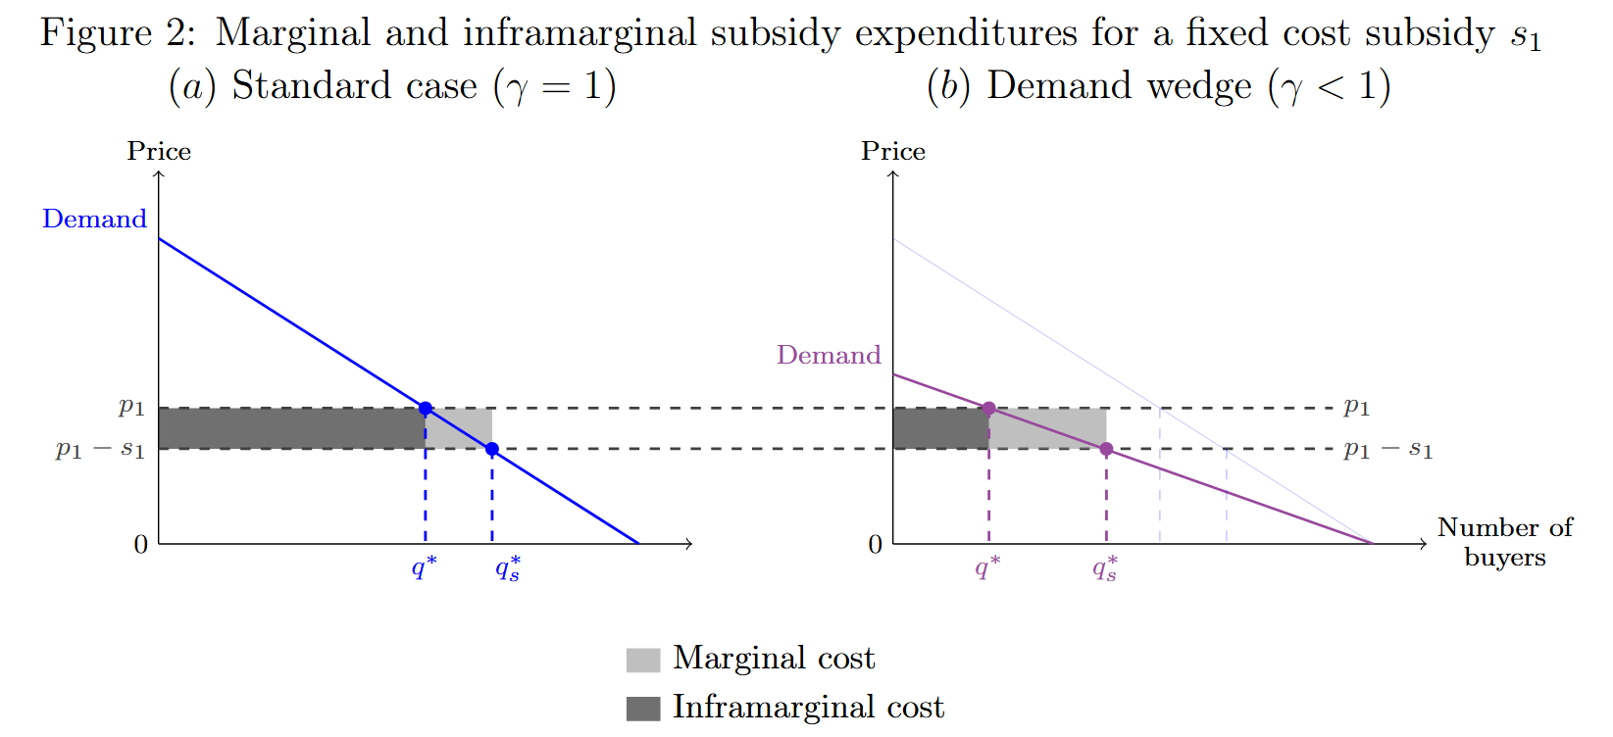
Theory: Marginal dollar has a higher impact on adoption

